Slide 1
Image-to-image
Translation Study
DSA5204
Yanrong Chen A0251099Y
Shuyuan Shen A0251155M
Yuhua Wang A0251546E
Geer Zhang A0251176H
Junhao Huang A0251318L

Slide 2
Table of contents
01
02
03
04
05
Background
Motivation
Models
Ablation Study
Conclusion

Slide 3
01.
Background
Using GAN and its extension to solve image-to-image translation

Slide 4
Image-to-image Translation
Introduction to the problem
Develop from texture transfer
Based on pixels and basic image feature
2 parts: image texture extraction and image reconstruction
GAN algorithm
Generator is used to reconstruct the image
Discriminator is used to distinguish the image

Slide 5
02.
Motivation
Understanding, Reproducing and Extending CycleGAN

Slide 6
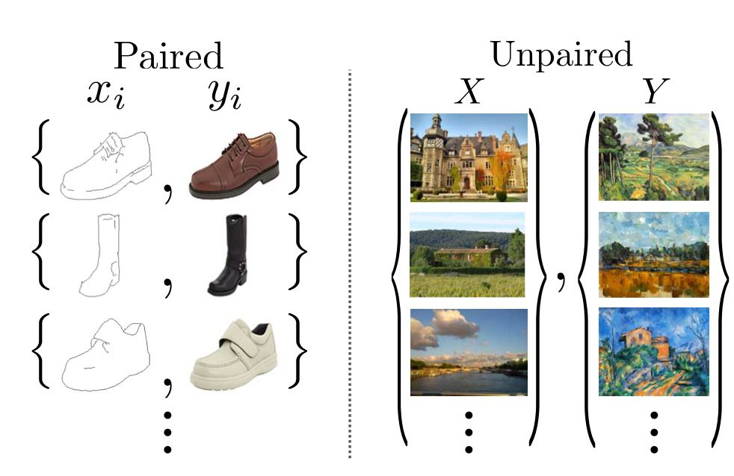
Paired to Unpaired
Paired data with supervised setting
Converting an image from one representation of a given scene, x, to another, y.
Obtaining data could be complex, expensive and false-defined.
Unpaired setting
Capturing special characteristics to find underlying relationship.
Exploiting supervision in two different domains and inducing an output distribution.

Slide 7
03.
Models
The comparison in model performance

Slide 8
Pix2pix
Introduction
Application
Comparison
Transforming a black and white image to a colored image.
Transforming edges into a meaningful image, given a boundary or information about the edges of an object, we realize a sandal image.
Transforming a low-resolution image to a high-resolution one
Versus CycleGAN:
1. number of networks (only 1 PatchGAN Discriminator and 1 Unet Generator)
2. works in pairwise images.
3.different loss function with L1 loss

Slide 9
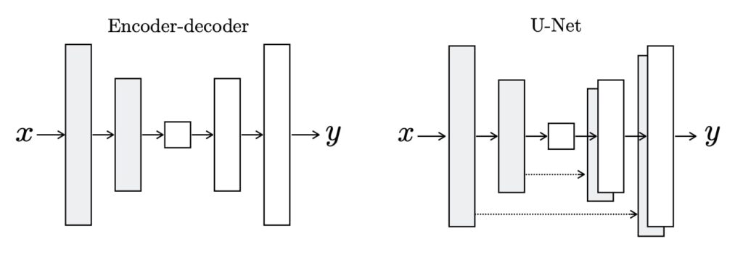
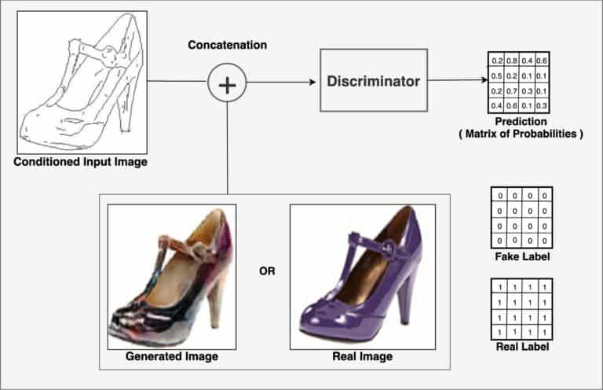
Pix2pix
Structure
Unet Generator
PatchGAN discriminator

Slide 10
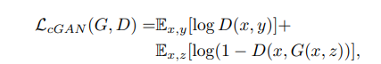
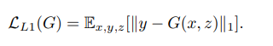
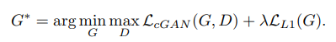
Pix2pix
Losses
Based on a conditional GAN’s loss function
Plus a L1 loss function
Final objective

Slide 11
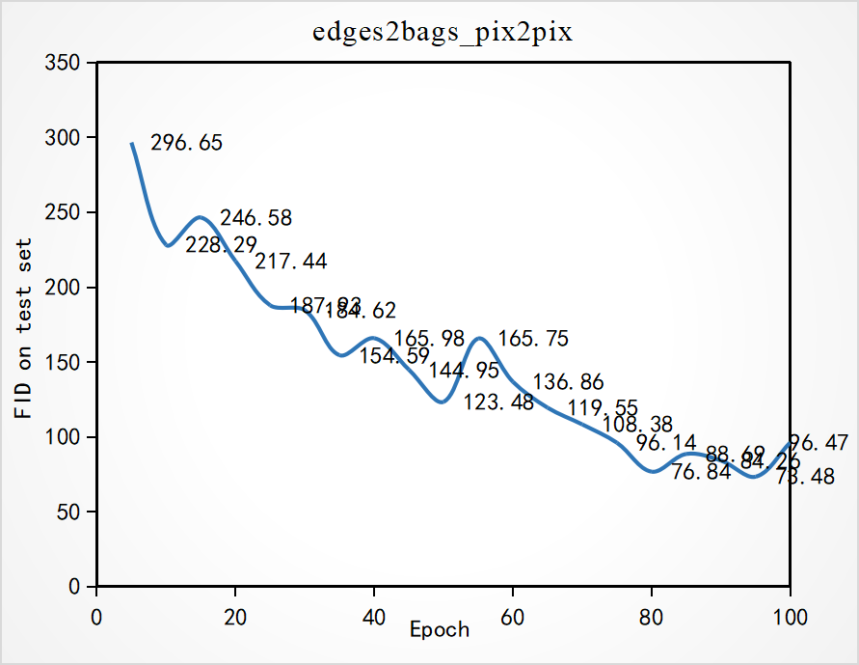
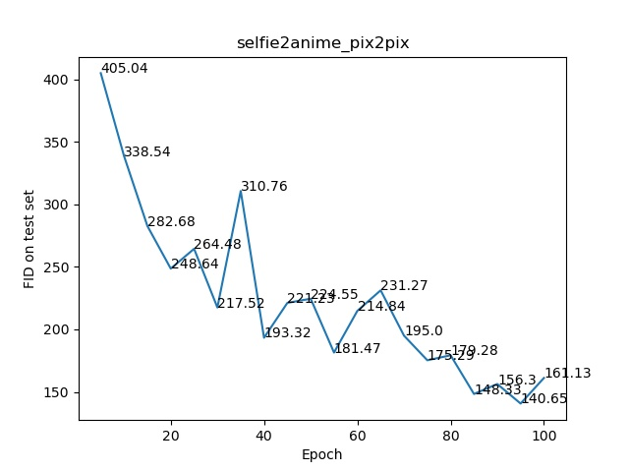
Pix2pix
Results
FID score on edges2shoes test datasets
FID score on selfie2anime test datasets
Notes:
FID is a measure of similarity between two datasets of images. It was shown to correlate well with human judgement of visual quality and is most often used to evaluate the quality of samples of Generative Adversarial Networks.

Slide 12
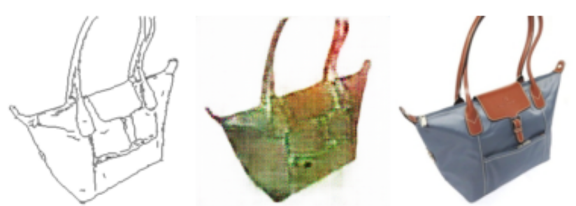
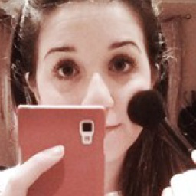
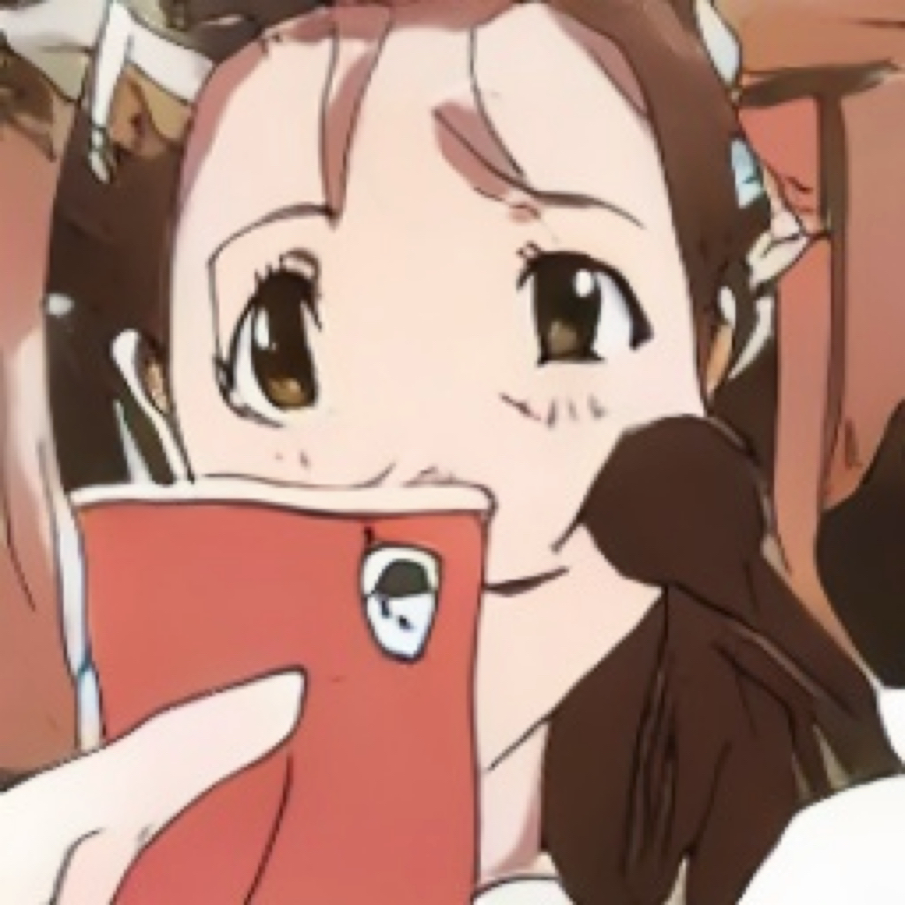
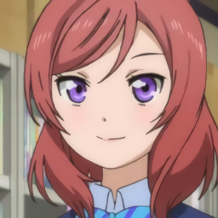
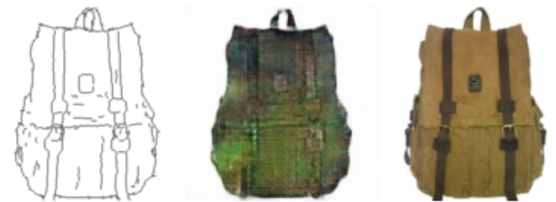

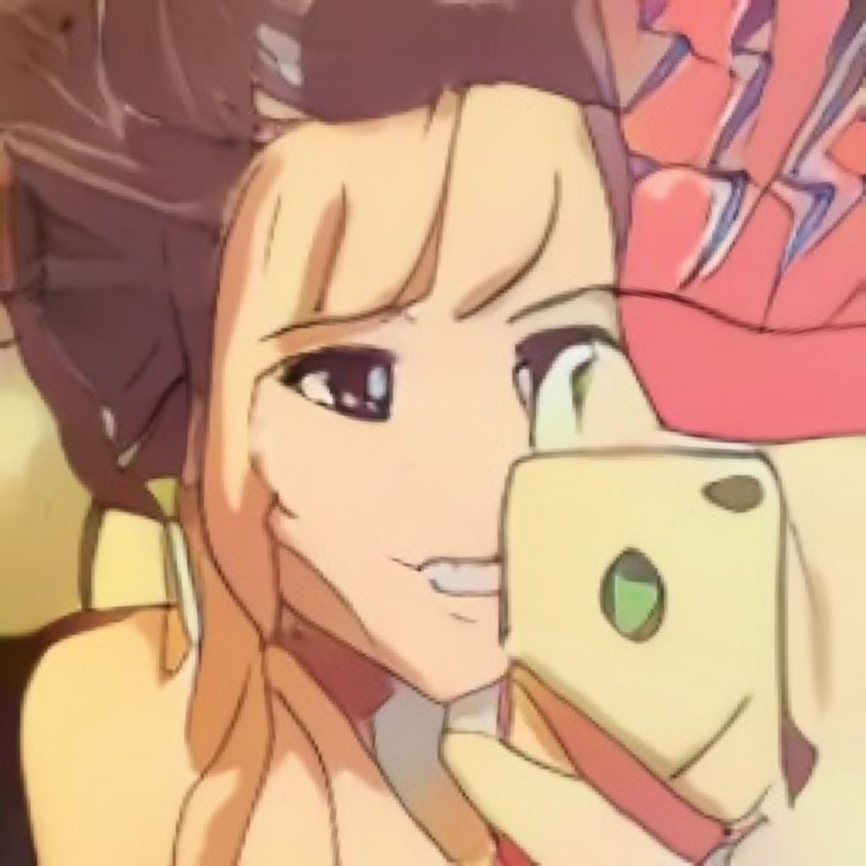

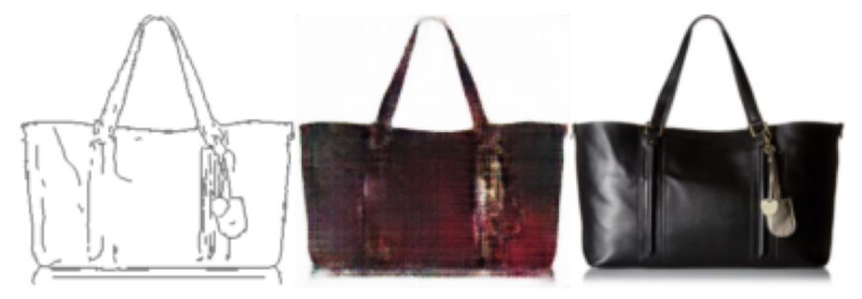
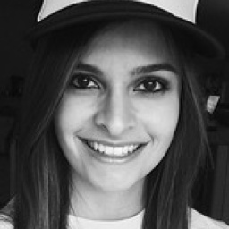

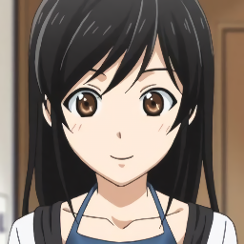
Pix2pix
Results on edges2shoes datasets
Results on selfie2anime datasets

Slide 13
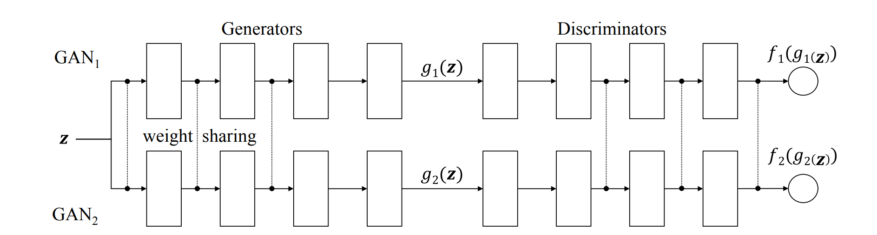
CoGAN
Structure

Slide 14
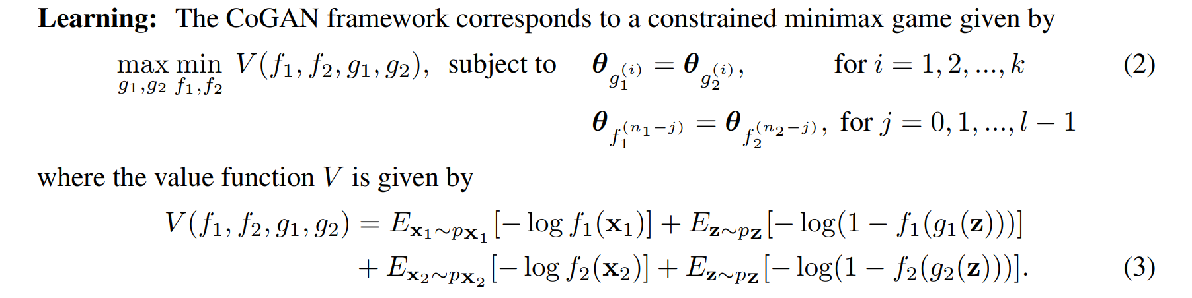
CoGAN
Loss

Slide 15
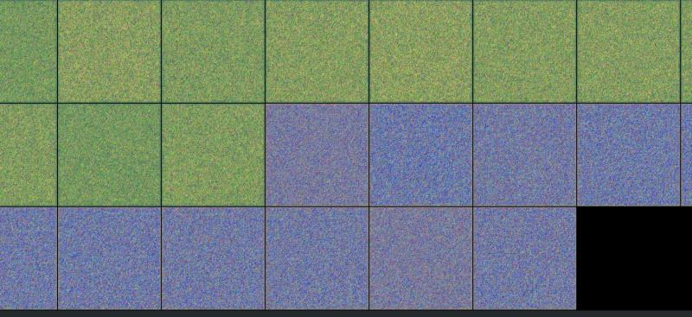
CoGAN
Results
Fail to study the image domains.
Too high resolution, may need more complex generator
Not very suitable for image to image translation
horse2zebra

Slide 16
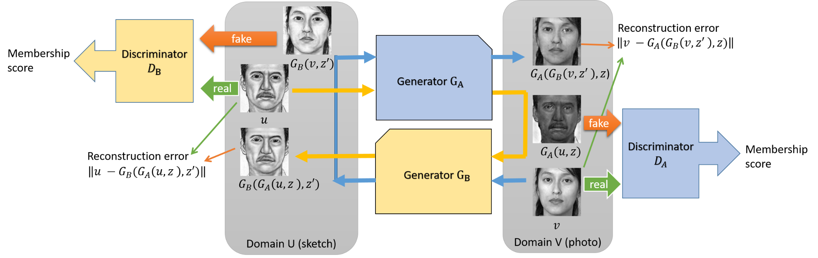
DualGAN
Structure

Slide 17
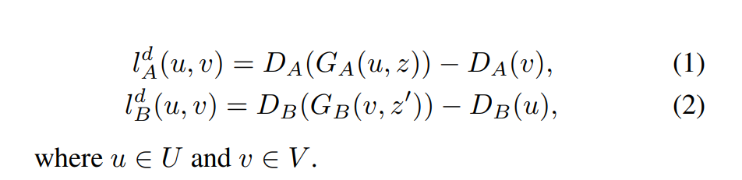
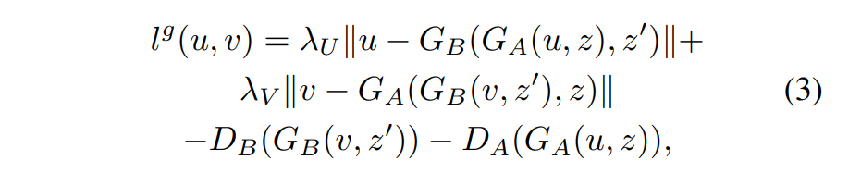
DualGAN
Losses
Use the loss format advocated by Wasserstein GAN (WGAN) rather than the sigmoid cross-entropy loss used in the original GAN.

Slide 18
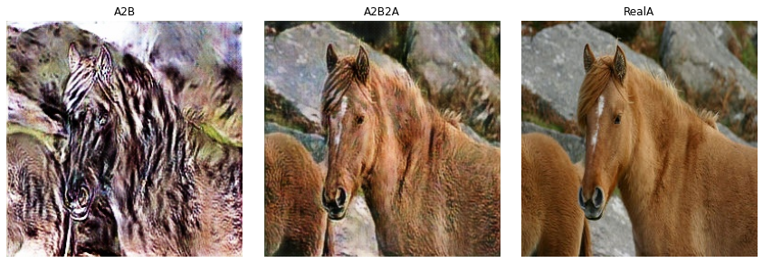
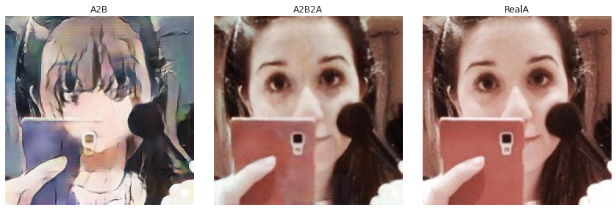
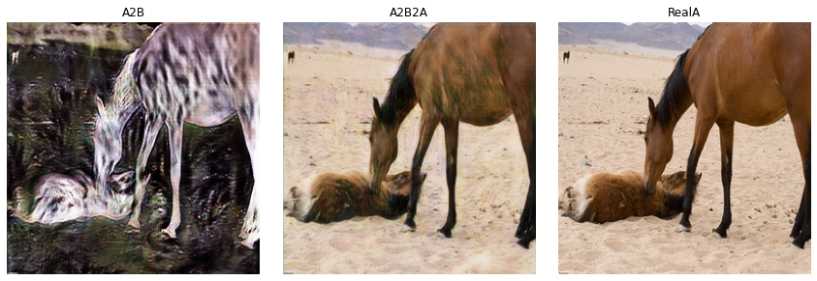
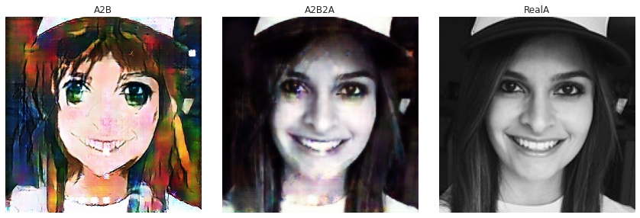
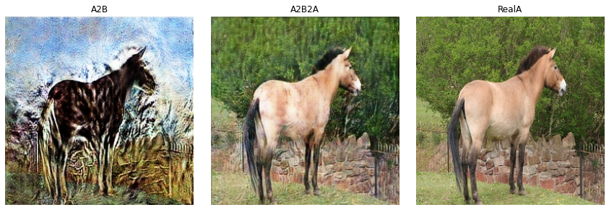
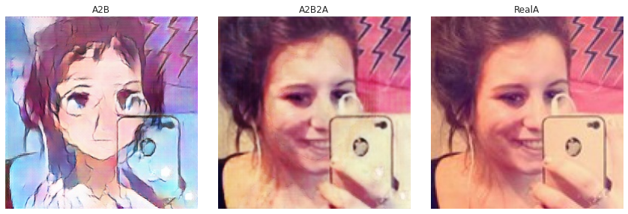
DualGAN
Results
horse2zebra
selfie2anime

Slide 19
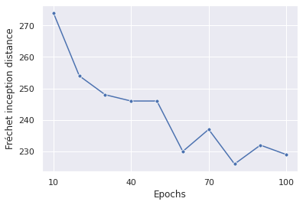
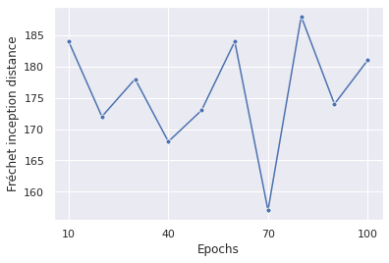
DualGAN
Results
horse2zebra
selfie2anime

Slide 20
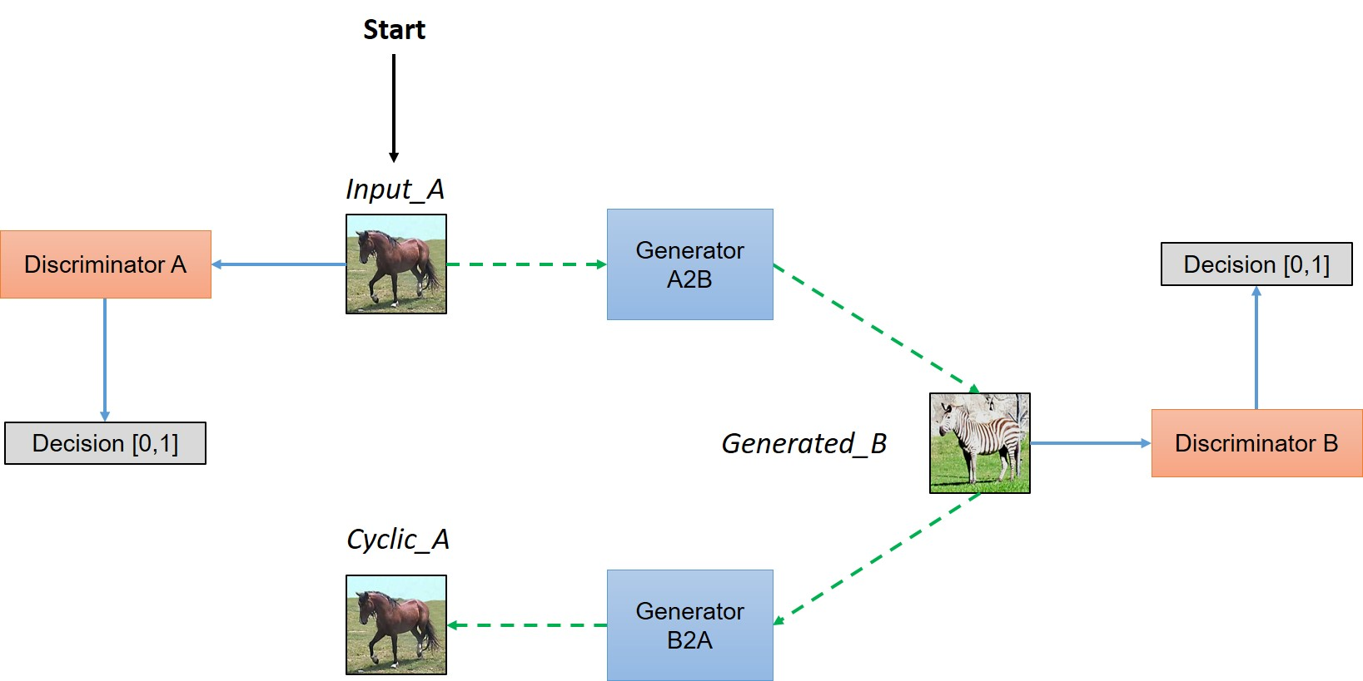
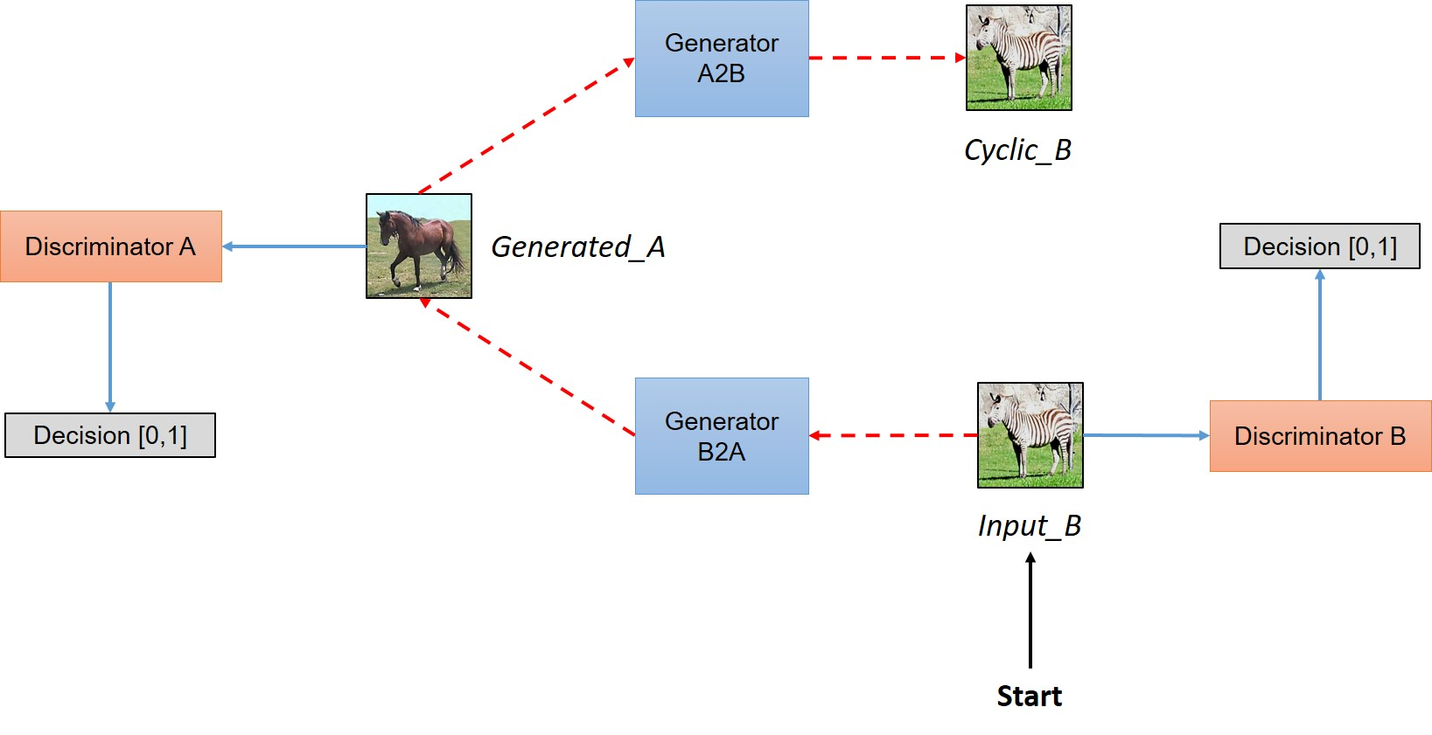
CycleGAN
Structure
Simplified view of architecture

Slide 21
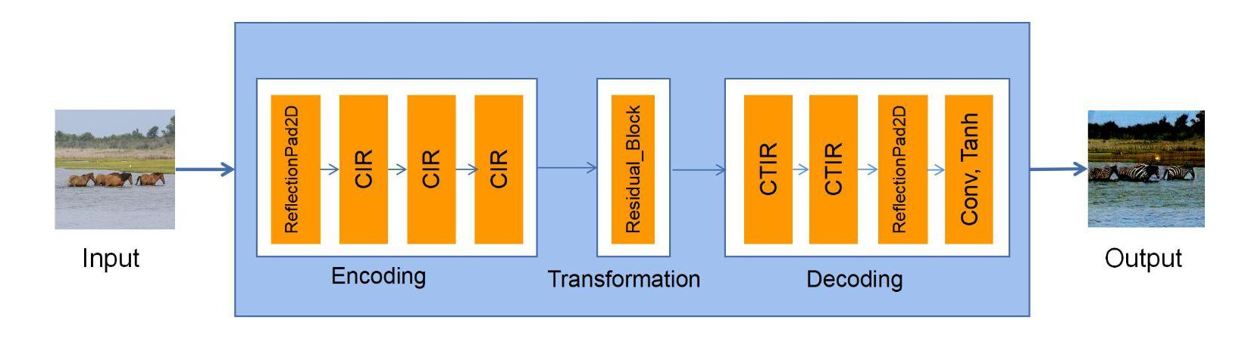
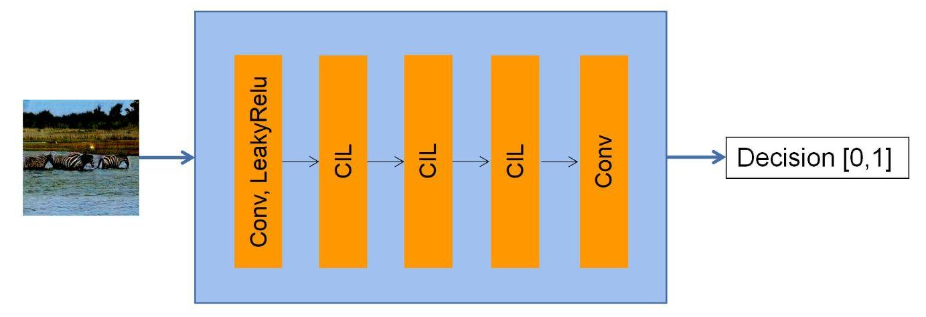
CycleGAN
Structure
Structure of the Generator
Structure of the Discriminator

Slide 22
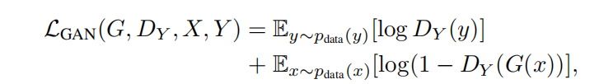
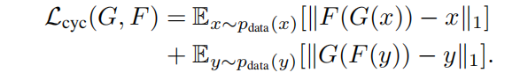
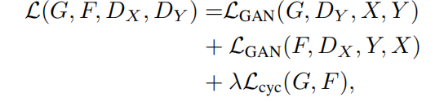
CycleGAN
Losses
Adversarial loss
Cycle consistency loss
Full Loss

Slide 23
CycleGAN
Losses
Optimization Problem

Slide 24
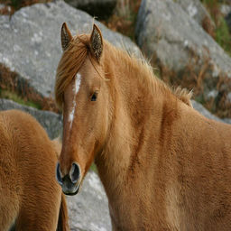
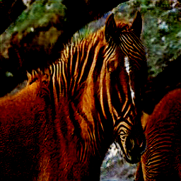
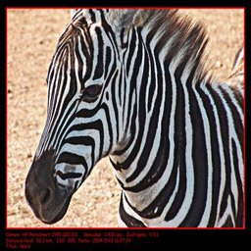

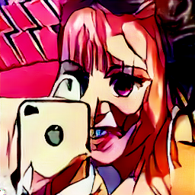

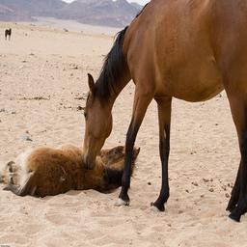
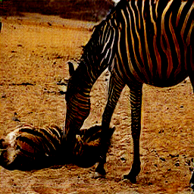
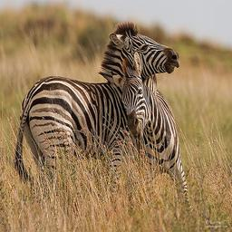

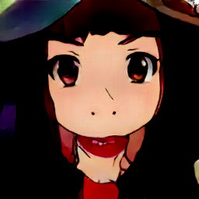
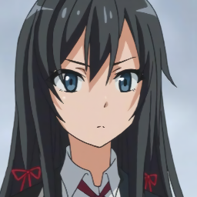
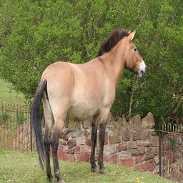
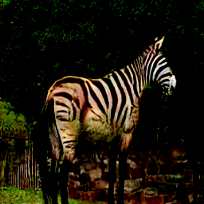
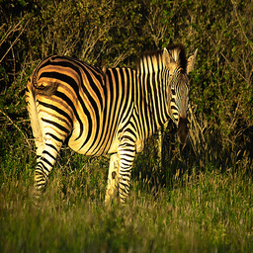



CycleGAN
Results
Results on horse2zebra datasets
Results on selfie2anime datasets

Slide 25


CycleGAN
Results
FID score on horse2zebra test datasets
FID score on selfie2anime test datasets

Slide 26
04.
Ablation study

Slide 27

CycleGAN - without cycle loss
Results
FID on selfie2anime datasets

Slide 28









CycleGAN - without cycle loss
Results
Original selfies
Without cycle loss
Without cycle loss A
Without cycle loss B

Slide 29



Spatial-Correlative Loss
Structure
Base on the structure of CycleGAN, Zheng et.al., (2021) proposed spatial correlative loss, which can learn the similarity map of the picture.
Loss
The calculation of each point in the spatial similarity matrix
The definition of spatial correlative loss
Notes:
For the spatially correlative loss, the structure is based on CycleGAN with a Resnet-based generator and a PatchGAN discriminator. This was based on the pre-trained VGG16 model to extract features. The cosine function was chosen as the feature distance calculation function, and an adversarial network was used with the least squares as the loss function.
Given an input image from a specific domain and its output in the target domain, both are fed into a pre-trained model to obtain their respective feature matrices. Instead of directly calculating the distance between the two feature matrices, a matrix is used to measure their similarity, which is called the Spatially-correlative map (in the slide). The input image 𝑥 and the transformed image 𝑦̂ are fed into the feature extractor, and their local similarity maps are calculated separately. The formula is as left shown:
Here, 𝑓 represents the 𝑥𝑖 feature with 𝐶 dimensions, and 𝑓𝑥 contains the corresponding features of 𝑁𝑝 points. The calculated 𝑆 represents the spatial similarity between the 𝑥𝑖 point and other points in the same region. Unlike the previous approach of directly extracting features from the images which includes the colors, lighting, and textures specific to the domain. However. these feature are not needed for style transfer Therefore., auto-correlation only captures spatially-related features.
After computing the Spatially-Correlative Map for each patch, all the spatial correlation matrices are combined with 𝑆 to represent the overall spatial correlation of the image, where 𝑁𝑠 is the number of sampled patches. The spatial loss function is defined as the comparison of the spatial similarity structure matrix between the input image 𝑥 and the output transformed image 𝑦̂ in the target domain, as left shown.

Slide 30









Spatial-Correlative Loss
Results
Results on horse2zebra datasets
Results on selfie2anime datasets
Notes:
Here we can see the result of replacing the loss with spatial correlative loss. Although there is still some error, such as the second picture, it also change the dog in to zebra. However we can see that the model can better keep the spatial structure and background with spatial correlative loss.

Slide 31


Spatial-Correlative Loss
Results (FID)
FID score on horse2zebra test datasets
FID score on selfie2anime test datasets
Notes:
In general the model have a better FID score but during the training the model fluctuate.

Slide 32

Why Spatial-Correlative Loss is better
Spatial-Correlative Loss can handle spatial structure of the image instead of simply computing the loss in feature level;
Notes:
This picture provides an example where the model's task is to transform a given street semantic map 𝑥 into a photo 𝑦. In this scenario, a good spatial structure loss function should provide negative feedback for incorrect results while maintaining successfulresults. As a result, the loss is very low in the correct region and very high in the incorrect region, effectively distinguishing the two regions. Therefore, self-learned similarity can preserve the original spatial structure while performing image style transfer.

Slide 33
05.
Conclusion

Slide 34
Our Works:
Implement Pix2Pix, CoGAN, DualGAN, CycleGAN and test on Selfie2anime dataset;
Compare the translation performance with visual inspection and Frechet Inception Distance (FID) score;
Perform ablation studies on CycleGAN to analyse the network structure;
Perform Spatial-Correlative Loss to improve the maintenance of spatial structure for CycleGAN;
Findings:
Pix2Pix requires paired images and would not compatible to our data;
CoGAN is hard to generate high-resolution images and it does not consider the “cycle loss”;
DualGAN shows similar structure with CycleGAN, but different losses;
CycleGAN adds reconstruction error to achieve forward-backward consistency;
By using spatial-correlative loss, the performance of the model beats the rest and generates images that is visually better;

Slide 35
06.
Q&A

